Slide 1

The Aga Khan Hospital Dar es Salaam
Dr. Christopher Mwansasu - OPA Documentation Compliance for Q4 2022

Slide 2
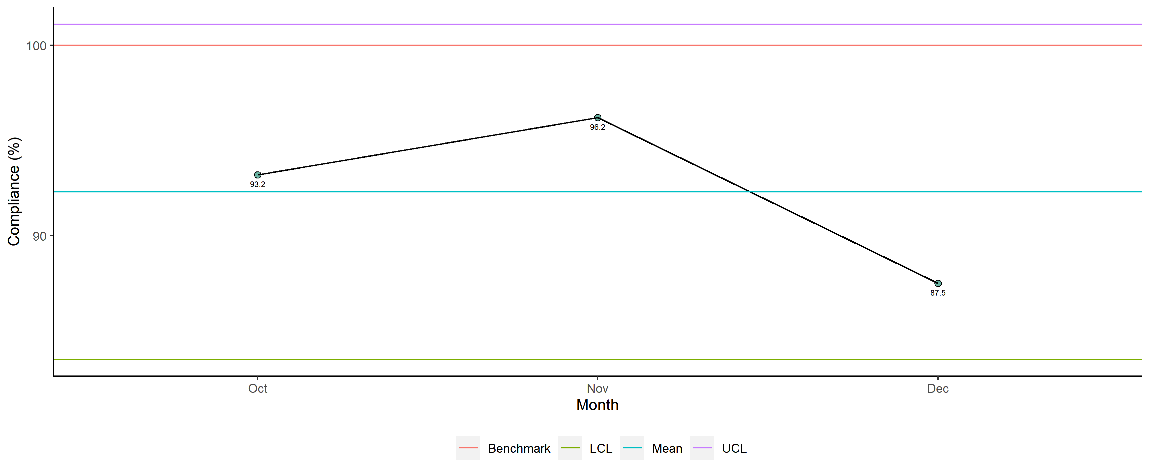
Dr. Christopher Mwansasu - Availability of Required Documents

Slide 3
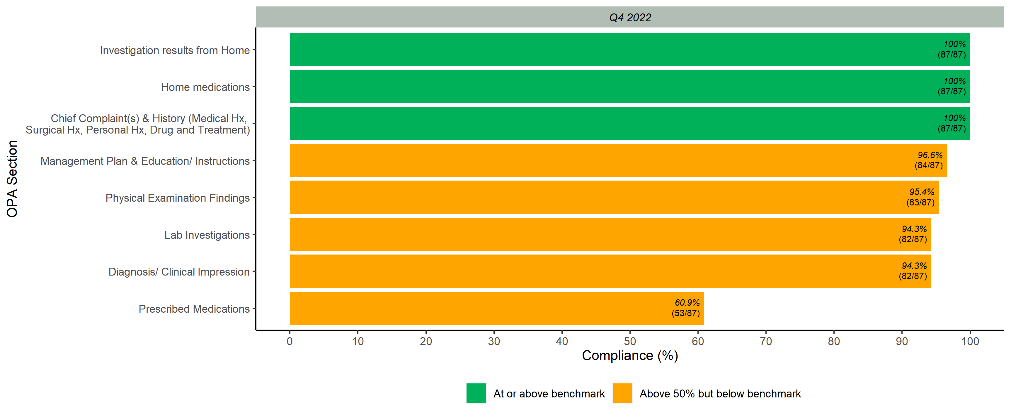
Documented Scores per OPA Section

Slide 4
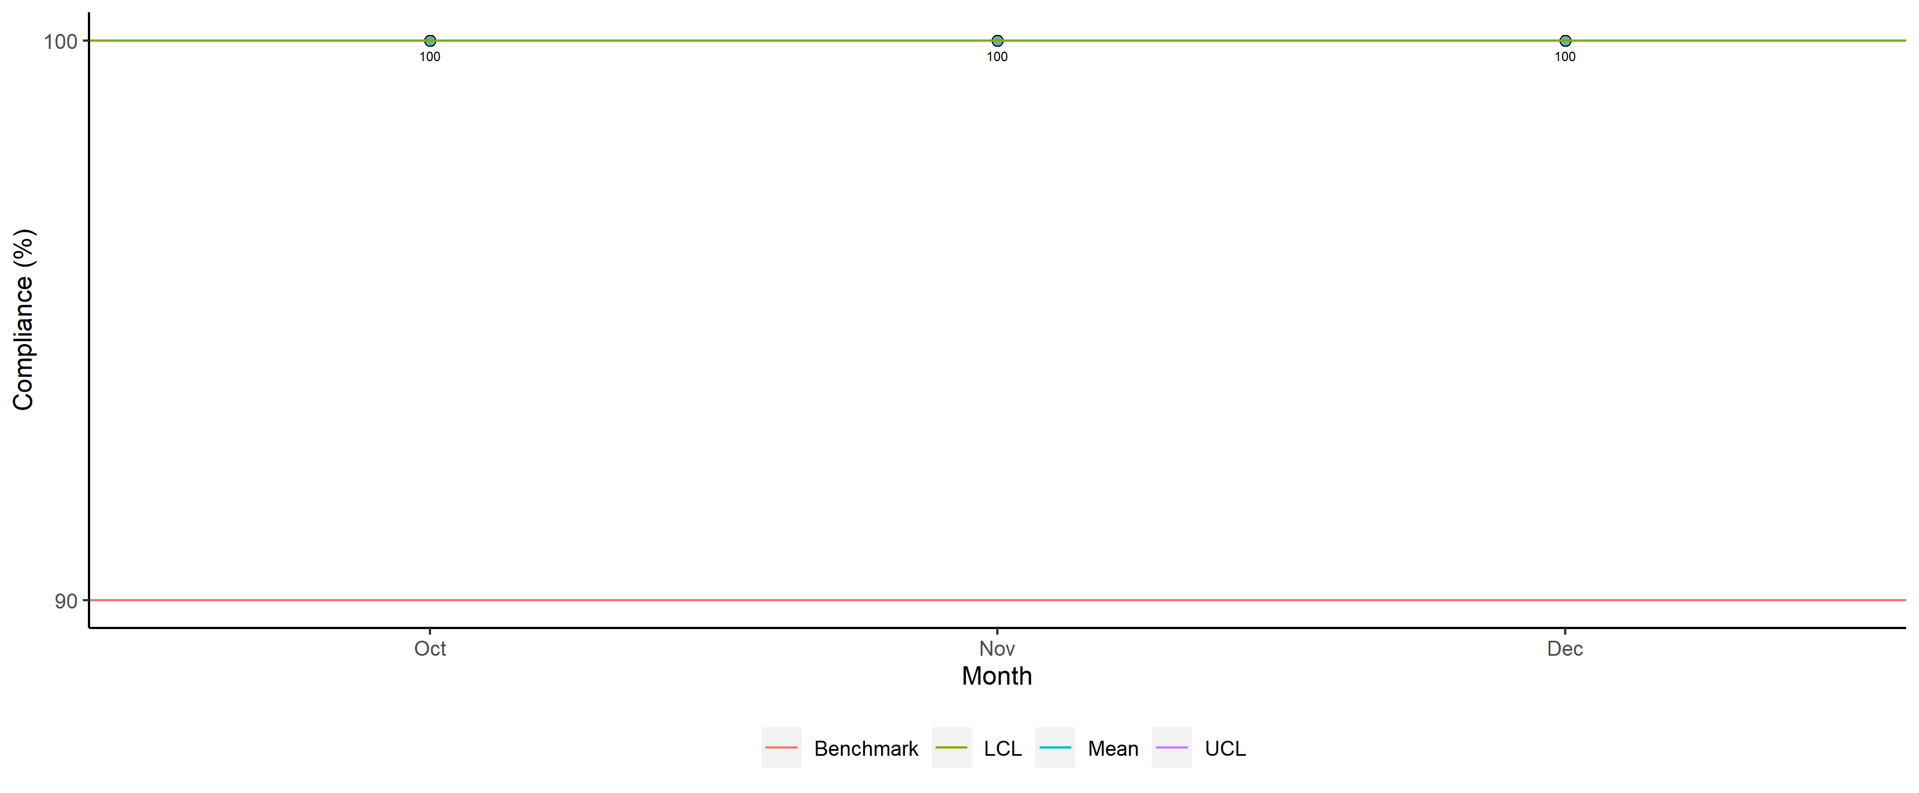
Dr. Christopher Mwansasu - Legibility

Slide 5
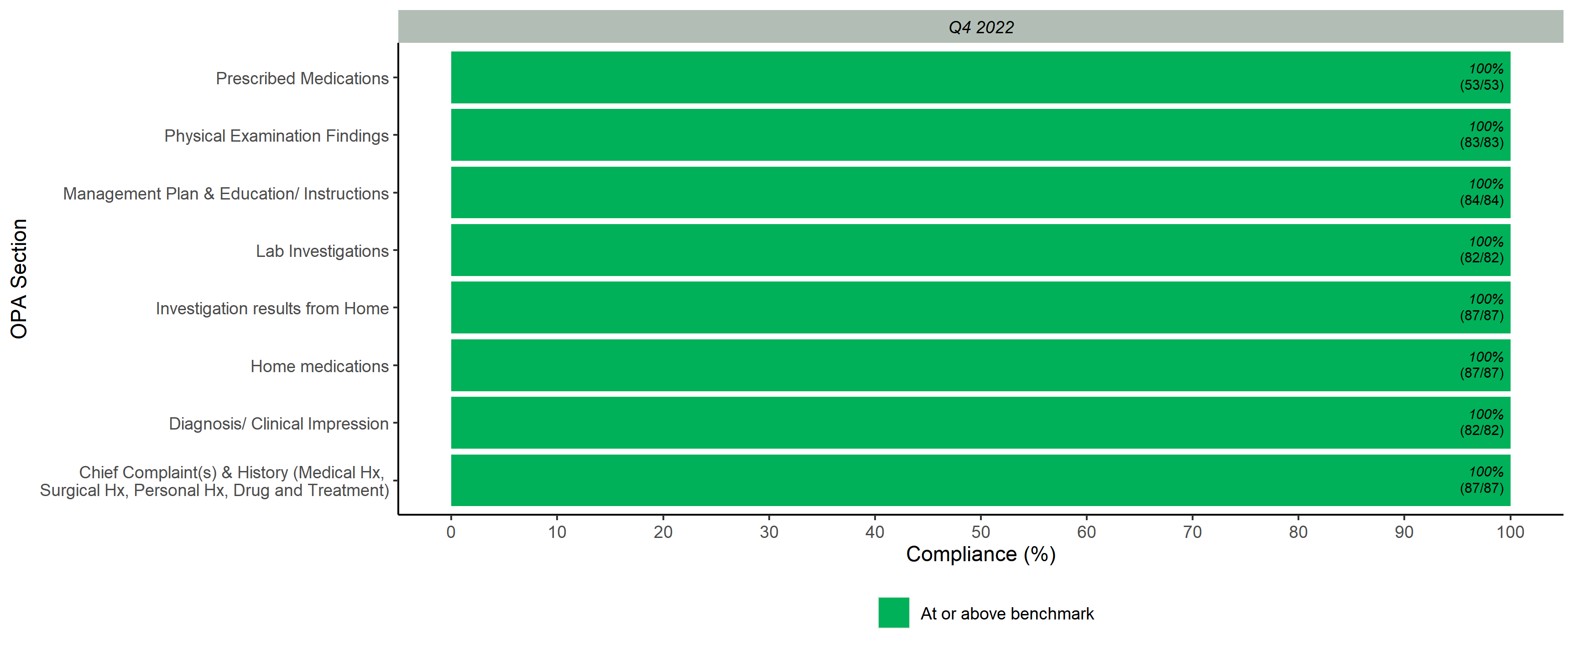
Legibility Scores per OPA Section

Slide 6
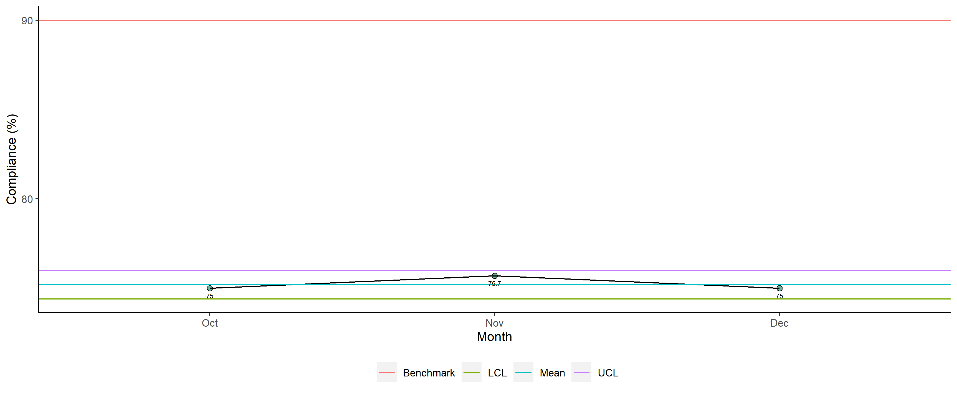
Dr. Christopher Mwansasu - Completeness

Slide 7
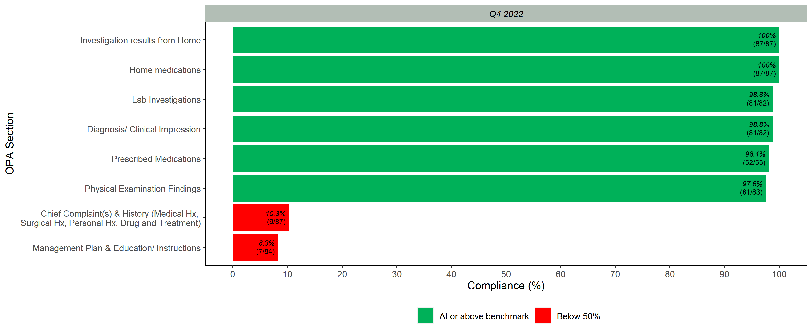
Completeness Scores per OPA Section

Slide 8
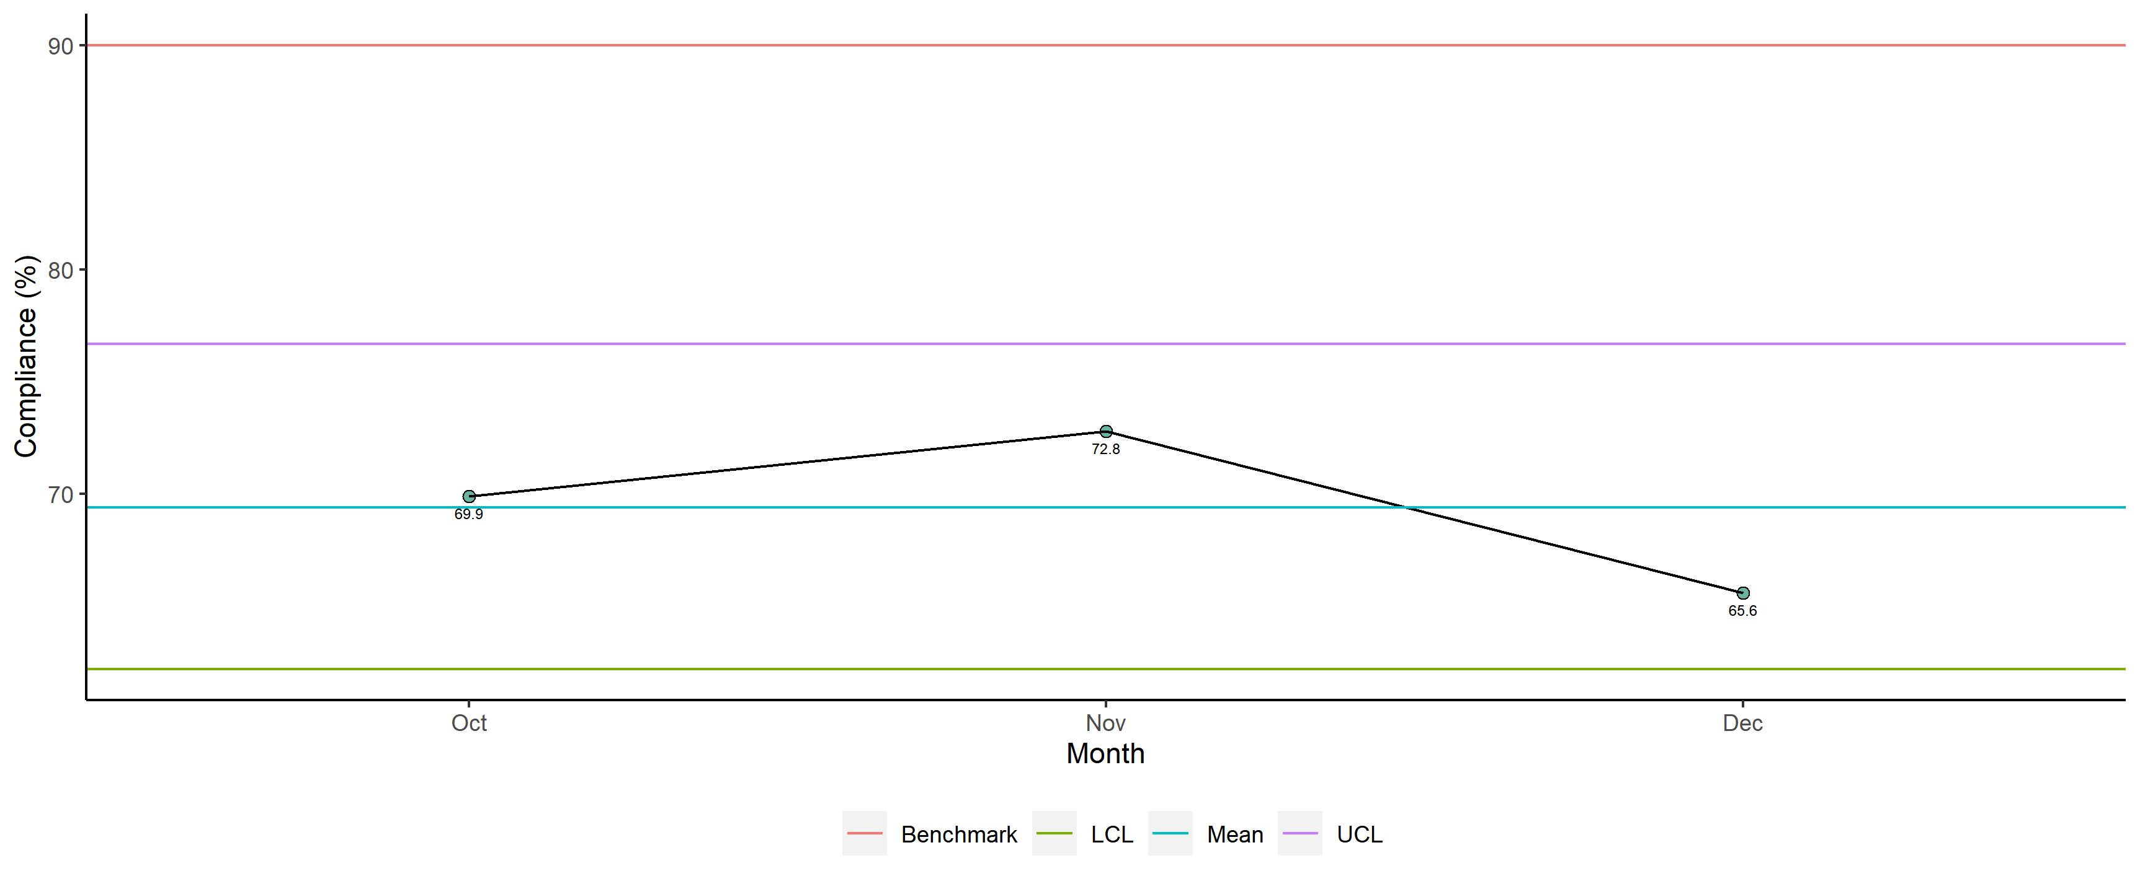
Dr. Christopher Mwansasu - Overall

Slide 9
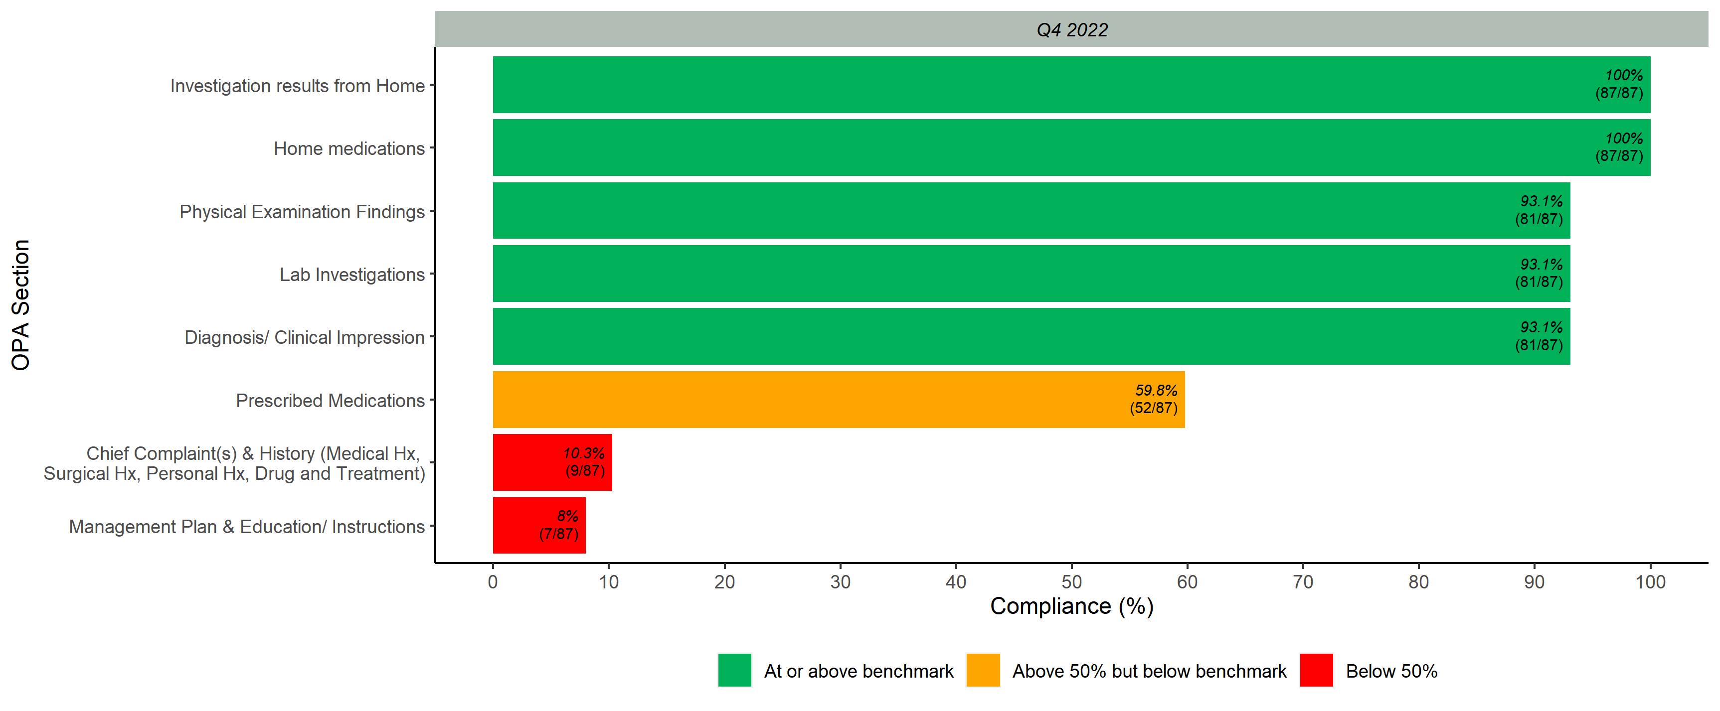
Overall Scores per OPA Section

